Slide 1
Apache Kafka
Software/Installer/Exercices

Slide 2
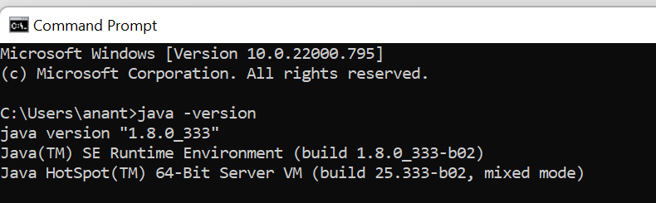
Installing Java (Windows)
JAVA 8 SDK is necessary for Zookeeper and Kafka
You can download and set it up from here (depending on your OS)
You would need to register to Oracle
Once downloaded and setup open a command prompt and type the following to confirm setup.

Slide 3
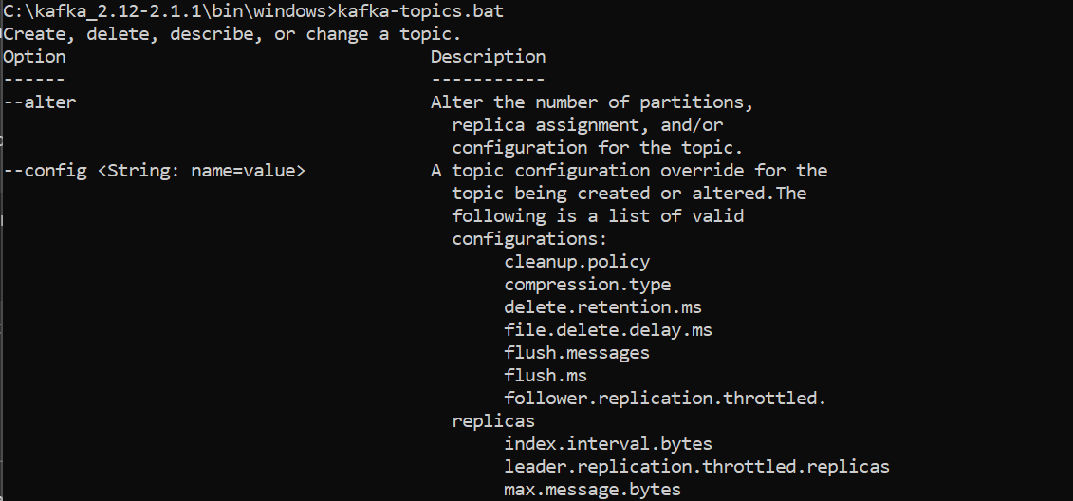
Installing Kafka (Windows)
Here we install Kafka binaries for Windows.
For this course we stick to 2.12 (though 3.2 is available).
You can download and set it up from here (depending on your OS)
Unzip and setup the PATH variables to bin folder of Kafka.
For windows, the batch files are in the folder ‘kafka_2.12-2.1.1\bin\windows’.
Open your command prompt in Admin mode. This is important for some windows machine where you don’t have permissions on your C drive.
Run the batch file shown, the output suggests your Kafka installation is running and fine.
You can setup your PATH variable to the above folder to run Kafka from anywhere in your system.

Slide 4
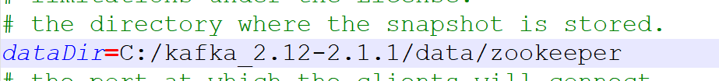
Configure & Start Zookeeper
In your ‘C:\kafka_2.12-2.1.1’ folder create a folder called ‘data’.
In ‘data’ folder create two more folders ‘zookeeper’ and ‘kafka’.
In folder ‘C:\kafka_2.12-2.1.1\config’ edit the ‘zookeeper.properties’ file.
Replace dataDir properties to your Zookeeper data folder. Replace \ with /
This is the only configuration change for Zookeeper.
C:\kafka_2.12-2.1.1 > zookeeper-server-start.bat config\zookeeper.properties
Zookeeper has started as shown above. It binds to port 2181

Slide 5
Configure & Start Kafka
Open another command prompt in admin mode for kafka.
In folder ‘C:\kafka_2.12-2.1.1\config’ edit the ‘server.properties’ file.
Replace logs.dir properties to your kafka data folder. Replace \ with /
This is the only configuration change for kafka for now.
C:\kafka_2.12-2.1.1 > kafka-server-start.bat config\server.properties
Kafka has started as shown above.

Slide 6
Offset Explorer
Java UI Tool to work with your Kafka Cluster
Bundled JRE
Free for personal use
Explore Topics, Partitions, Producers, Consumers and More
Download

Slide 7
IntelliJ IDE for Development
IntelliJ community is a great IDE for development in a multitude of languages (given plugins).
We will use this for our Java samples here.
You can download community from here.
When you create a Java project using Maven, initially a lot of time gets consumed to download Maven dependencies. This is one time exercise and is ok. Maven is the build tool used in the examples.
You will be able to execute sample Java code for reproducing CLI behaviours.
You will also learn to develop a real-world example with Titter data consumption.

